Slide 1
Plus FCE
Job Application

Slide 2
Discuss THE TOPIC. • What procedures does one go through when applying for a job? • What do you think should be included in a letter/email of application?

Slide 3
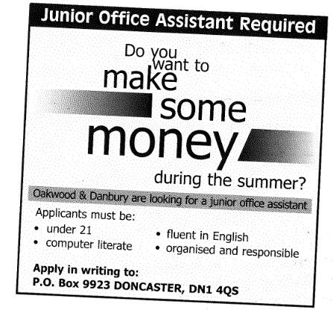
Sample Writing
Read the rubric and the sample letter below. The advertisement contains an illegal statement. Find it and cross it out. The letter also includes information
that is not appropriate for a letter of this type. Find it and cross it out.
You have seen this advertisement and have decided to apply for the job. Write your letter of application (120-180 words).

Slide 4
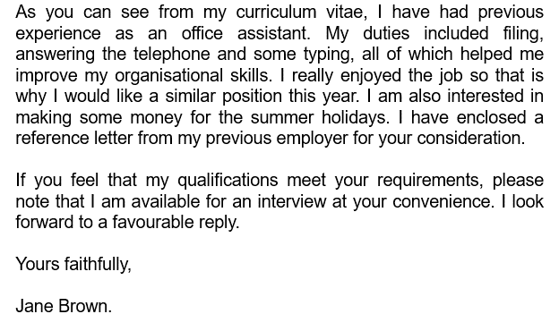
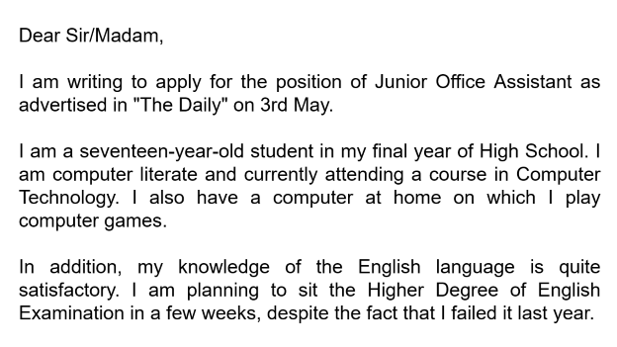



Slide 5
Dear Sir/Madam,
I am writing to apply for the position of Junior Office Assistant as advertised in "The Daily" on 3rd May.
I am a seventeen-year-old student in my final year of High School. I am computer literate and currently attending a course in Computer Technology. I also have a computer at home on which I play computer games.
In addition, my knowledge of the English language is quite satisfactory. I am planning to sit the Higher Degree of English Examination in a few weeks, despite the fact that I failed it last year.

Slide 6
As you can see from my curriculum vitae, I have had previous experience as an office assistant. My duties included filing, answering the telephone and some typing, all of which helped me improve my organisational skills. I really enjoyed the job so that is why I would like a similar position this year. I am also interested in making some money for the summer holidays. I have enclosed a reference letter from my previous employer for your consideration.
If you feel that my qualifications meet your requirements, please note that I am available for an interview at your convenience. I look forward to a favourable reply.
Yours faithfully,
Jane Brown.

Slide 7
1 Answer these questions. a. Is the person suitable for the job? Why/ Why not?
b. What is a curriculum vitae (CV) and a reference?
Possibly, but she does herself no favours writing that she plays computer games because it makes her sound immature. She did not need to say that she failed her exam last year.
CV stands for curriculum vitae, which is Latin for “course of life.” It’s a brief account of a person's education, qualifications, and previous experience, typically sent with a cover letter when applying for a job. The American term is resume.
A reference is a statement about a person’s qualifications,
character, and dependability written by someone who knows
that person.

Slide 8
2 Suppose the advertisement had the following extra point: Applicants must be available in July. What would you include in the letter in order to cover this point?
In the space below write your answer in an appropriate style.
The date the school year and computer course end and a clear statement of your availability throughout July.
The school year ends on 17 June and the computer course ends on 20 June, so I will be available to work throughout July.
In which part of the letter would you add it?
Paragraph 4 after “summer holiday.”
I am a seventeen-year-old student in my final year of High School. I am computer literate and currently attending a course in Computer Technology.
The school year
ends on 17 June and the computer course ends on 20 June, so I will be
available to work throughout July.

Slide 9
This unit deals with letters of application. What you include in the letter and how you organise it will depend on the rubric. Below is a general plan of a letter of application, with questions to help you when planning one. Read the plan and compare it to the sample.

Slide 10
Greeting
• use a formal greeting
use set phrases to state: • which position you are applying for. • where/when you saw the advertisement.
Why are you writing this letter? What job are you applying for? Where / When did you see the advertisement? How old are you?
Opening paragraph
What have you studied? Can you speak any foreign languages? What sort of work experience have you had? What do/did you do in your present/previous job? What are some of your interests that are relevant to the job? What else do you think makes you a suitable applicant?
Main part
2-3 paragraphs
• mention your age
• ask for anything they did not make clear/ • describe your qualifications and experience • state your present/previous job, if relevant • state any interests/hobbies which are relevant • explain why you believe you are suitable for the job
• use set phrases to state that: • you hope your application will be
taken into consideration • you enclose a CV/reference
Closing paragraph
Are you enclosing a CV or a reference? Is there anything you want to emphasise? When would you be available for an interview? When would you be available to start?
Signing off
• use a formal sign off

Slide 11
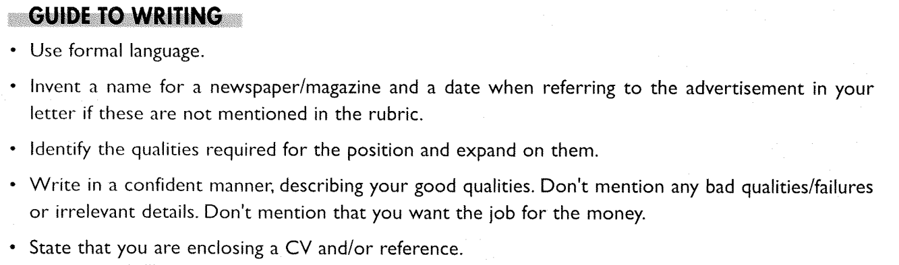

Slide 12
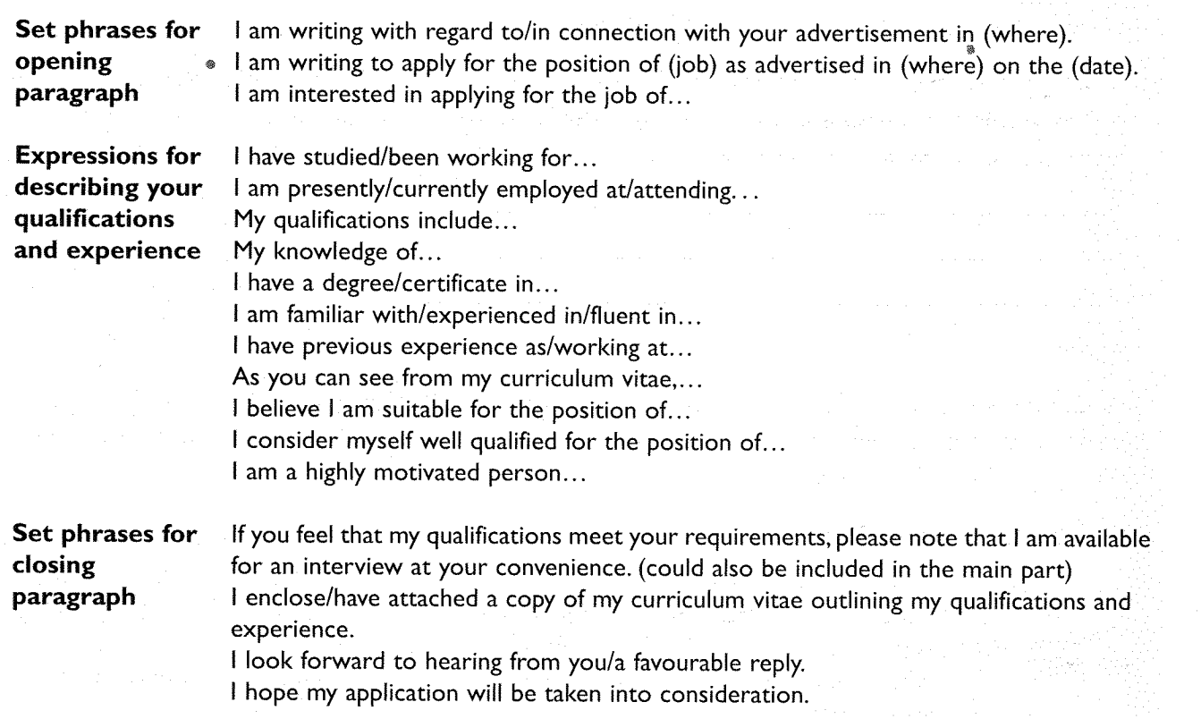

Slide 13
Writing Practice
You saw the following advertisement in the South Wales Echo on 7 July 2022 18 June 2026. You are interested in applying, but also want to ask for some extra information. Look at the advertisement; what questions could you ask?

Slide 14
Are you looking for a fun part-time job?
Galiano’s Café
is looking for kitchen and waiting staff
to work evenings and weekends
We offer
basic training, and competitive rates of pay.
If you are friendly and energetic, then
write to us explaining why you think
you would be suitable for the job.
Please send your CV, and
a cover letter to
The Manager
Galiano’s Café
1 Canal Parade,
Cardiff Bay
Cardiff
CF10 7HE

Slide 15
How many hours?
Are there a minimum number of hours?
Overtime?
Are you looking for a fun part-time job?
Galiano’s Café
is looking for kitchen and waiting staff
to work evenings and weekends
We offer
basic training, and competitive rates of pay.
Either or both jobs
Either or both shifts?
What will this involve?
How much will I be paid?

Slide 16
Now plan and write a letter applying for the job and asking for the missing information. Use the layout for letters that we learnt in the last lesson.
Plans should include content and sequence and show which paragraph the content goes in.

Slide 17
Format:
We do not know the name of the manager, so
we begin with
Dear Sir/Madam,
We end with
Yours faithfully,
We sign off with our first name and surname.

Slide 18
Let’s go back to the jigsaws to remind ourselves of the layout we need.

Slide 19

City
Postcode
Number and street
Area

Slide 20
City
Postcode
Number and street
Area

Slide 21
Number and street
Area
City
Postcode

Slide 22
Example

Slide 23
Cardiff
CF10 7HE
99 Fake Street
Splott

Slide 24
Cardiff
CF10 7HE
99 Fake Street
Splott

Slide 25
99 Fake Street
Splott
Cardiff
CF10 7HE

Slide 27
City
Position
Number and street
Postcode
First name and surname
Company name
Area

Slide 28
City
Position
Number and street
Postcode
First name and surname
Company name
Area

Slide 29
First name and surname
Position
Company name
Number and street
Area
City
Postcode

Slide 31
Formal letter:
Recipient’s surname is unknown but the position is known.

Slide 32


Date
Dear Sir/Madam,
Your address
Your postcode
Position
Company name
Their address
Their postcode
Body
Yours faithfully,
Your first name+surname.

Slide 33
Date
Dear Sir/Madam,
Your address
Your postcode
Position
Company name
Their address
Their postcode
Body
Yours faithfully,
Your first name+surname.

Slide 34
Your address
Your postcode
Date
Position
Company name
Their address
Their postcode
Dear Sir/Madam,
Body
Yours faithfully,
Your first name+surname.

Slide 35
Example

Slide 36
Body
99 Fake St
Splott
Cardiff
CF16 8XY
John Doe.
Dear Sir/Madam,
Customer Service Manager
Widgets Ltd
99 Fake Street
City Centre
Cardiff
CF10 7HE
Yours faithfully,
7 February 2022

Slide 37
Body
99 Fake St
Splott
Cardiff
CF16 8XY
John Doe.
Dear Sir/Madam,
Customer Service Manager
Widgets Ltd
99 Fake Street
City Centre
Cardiff
CF10 7HE
Yours faithfully,
7 February 2022

Slide 38
99 Fake St
Splott
Cardiff
CF16 8XY
7 February 2022
Customer Service Manager
Widgets Ltd
99 Fake Street
City Centre
Cardiff
CF10 7HE
Dear Sir/Madam,
Body
Yours faithfully,
John Doe.

Slide 39
Glossary/Useful vocabulary
basic training training for new personnel on how to do their job.
cover letter a letter sent with an application form or CV when applying for a job.
entail (v) involve something as a necessary or inevitable part or consequence. E.g. The training will entail learning how to maintain basic hygiene, how to cook items on the menu and how to use the cash register.
shift (n) the part of the day when someone does their work. E.g. Someone who works in the evening works the evening shift.
waiting staff waiters and waitresses.
willing You are willing to do something if you have no objections to doing it.
In your advertisement, you say…
Your advertisement mentions…

Slide 40

the South Wales Echo
which appeared in
your
I am writing
in connection with
on 7 July 2022.
advertisement

Slide 41
the South Wales Echo
which appeared in
your
I am writing
in connection with
on 7 July 2022.
advertisement

Slide 42
on 7 July 2022.
the South Wales Echo
which appeared in
advertisement
your
in connection with
I am writing

Slide 43
for
advertisement
you
waiting
and
staff.
looking
says
Your
are
kitchen

Slide 44
advertisement
for
you
waiting
and
staff.
looking
says
Your
are
kitchen

Slide 45
Your
advertisement
says
you
are
looking
for
kitchen
and
waiting
staff.

Slide 46
roles?
are
me
combined
tell
you
if
Could
these
separate
or

Slide 47
roles?
are
me
combined
tell
you
if
Could
these
separate
or

Slide 48
Expression
of
Interest
Question word
…
Could
you
tell
me
if
these
are
combined
or
separate
roles?
{
Use if/
whether when there is no question word.
The expression of interest is a question,…
…so we end with a question mark.

Slide 49
or
both.
am
quite
to
either
do
happy
I

Slide 50
or
both.
am
quite
to
either
do
happy
I

Slide 51
I
am
quite
happy
to
do
either
or
both.

Slide 52
whether
I
choose
shift
to know
.
like
my
can
also
I would

Slide 53
whether
I
choose
shift
to know
.
like
my
can
also
I would

Slide 54
I would
also
like
to know
whether
I
can
choose
my
shift
.

Slide 55
Expression
of
Interest
Question word
…
I would
also
like
to know
whether
I
can
choose
my
shift
.
{
Use if/
whether when there is no question word.
The expression of interest is not a question,…
…so we end
with a full stop.

Slide 56
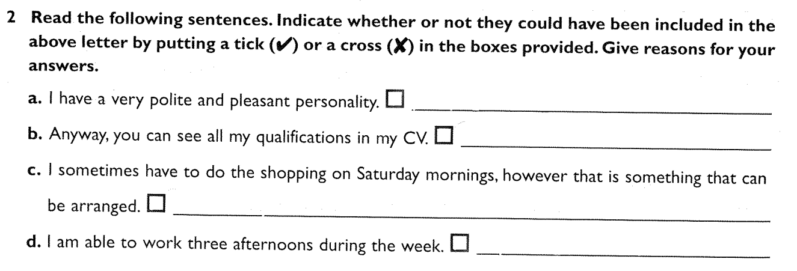
P
This is one of the job requirements.
O
Anyway is informal. In addition, the writer
cannot even be bothered to point out which of their qualifications are most relevant.
O
If it can be arranged, arrange it and don’t put doubts into the recruiter’s mind.
P
This shows your availability.

Slide 57
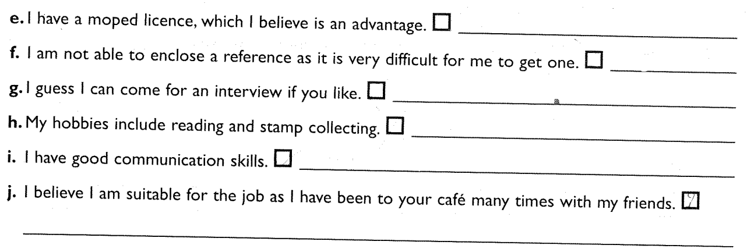
O
It is not relevant to this particular job.
O
You wouldn’t enclose
one yet, anyway. However, difficult it may be, you need to get one.
O
This is far too informal and does not give them a
reason to invite you.
O
This is not relevant to the job.
P
This is a job requirement.
Probably not. Certainly, it has to be true and will depend on your friends behaviour and maturity. It probably has as many advantages as disadvantages.

Slide 58
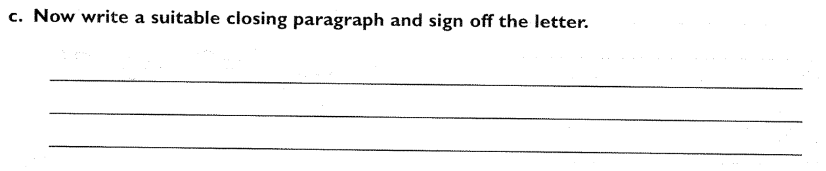

Slide 59
I would
you.
and qualifications
welcome a
from
with you.
to hearing
l look forward
personal interview
meet your
requirements,
If my experience

Slide 60
I would
you.
and qualifications
welcome a
from
with you.
to hearing
l look forward
personal interview
meet your
requirements,
If my experience

Slide 61
you.
from
to hearing
l look forward
with you.
personal interview
welcome a
I would
requirements,
meet your
and qualifications
If my experience

Slide 62
Now plan the main part. Then write your letter.

Slide 63

You have just read this advertisement in the local newspaper (South Wales Echo) and have decided to apply for the job. However, you have a few questions such as, but not limited to the number of hours, rate of pay, fuel costs and whether you can work in just one town or city.
Write an email of application using an appropriate layout.
People required to conduct surveys in shopping centres in Cardiff, Penarth, Newport, Caerphilly and Pontypridd.
You must have excellent communication skills and know the area well.
Your own transport an advantage.
To apply, please email: jobs@marrketdynamics.co.uk

Slide 64
email

